Slide 1

Dainity Consultancy

Slide 2

Improve your ROI with scalable PPC marketing
Dainity is rated in the top 1% of digital marketing agencies. Blending performance with exceptional customer service, our PPC specialists are some of the best in the industry with a track record for growing successful businesses
20XX
<number>
Notes:
<number>

Slide 3

Abou US
Dainity is a full-service digital agency located in Cleveland, OHIO . Founded in 2011, Dainity has a team of nearly 100 designers, writers, developers, marketers, and problem solvers who work tirelessly to make websites successful. Dainity offers its clients creative ways to build, plan, and promote their website. They focus on web design, PPC marketing, and organic SEO.
<number>

Slide 4



Market summary
Reach audiences with 33% higher incomes and 29% higher purchasing power with Dainity
.
Keep your business top of mind with the right marketing channels at the right time
With over 50 years of local marketing experience, Dainity knows the best offers to generate results.
<number>

Slide 5


Our Business Plan Overview
20XX
Dainity business plan
<number>
Notes:
<number>

Slide 6
A common worry we come across when talking about digital marketing planning is the fear of accidentally 'forgetting about' or leaving out potential opportunities for digital marketing. This is a very valid concern, given the vast number of digital media and platform options out there.
That's where our RACE Framework comes in - structured across Reach, Act, Convert, and Engage. Our RACE marketing plan starts with the first discovery of your brand by customers - how they 'reach' you, and continues across the customer journey, through to their first purchase, and then continuing to become a loyal fan and advocate.
Without a strategic approach, crucial touchpoints can get missed out..
Case in point, here is an example of a typical customer lifecycle for a marketer's business before implementing RACE analysis. This reflects the kind of activities that we see running as 'always on' marketing for small businesses before they implement RACE. They have often grown 'organically', based on uninformed opinions of 'what marketing should we do?'

Slide 7
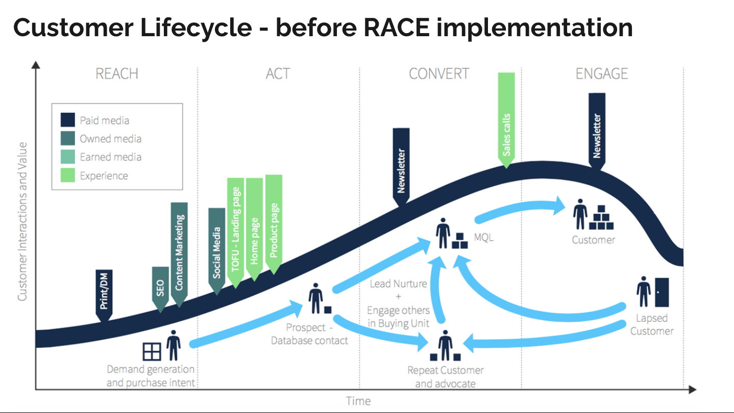
10/26/2023
<number>

Slide 8
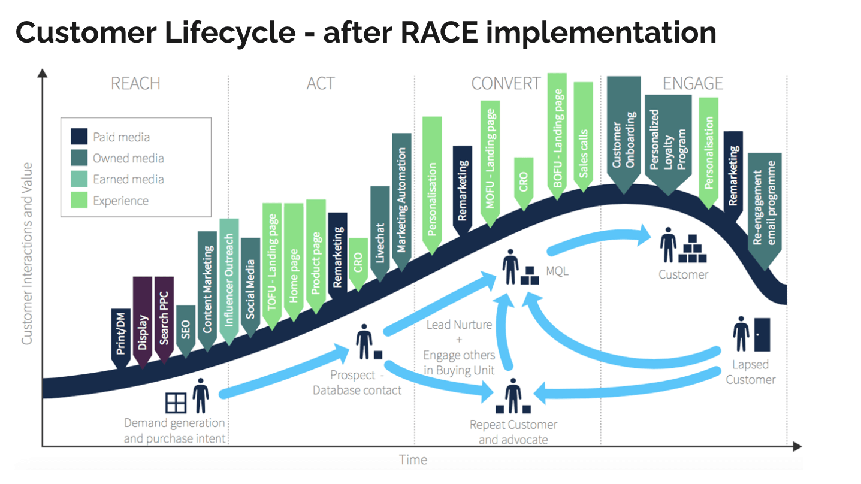
10/26/2023
<number>

Slide 9

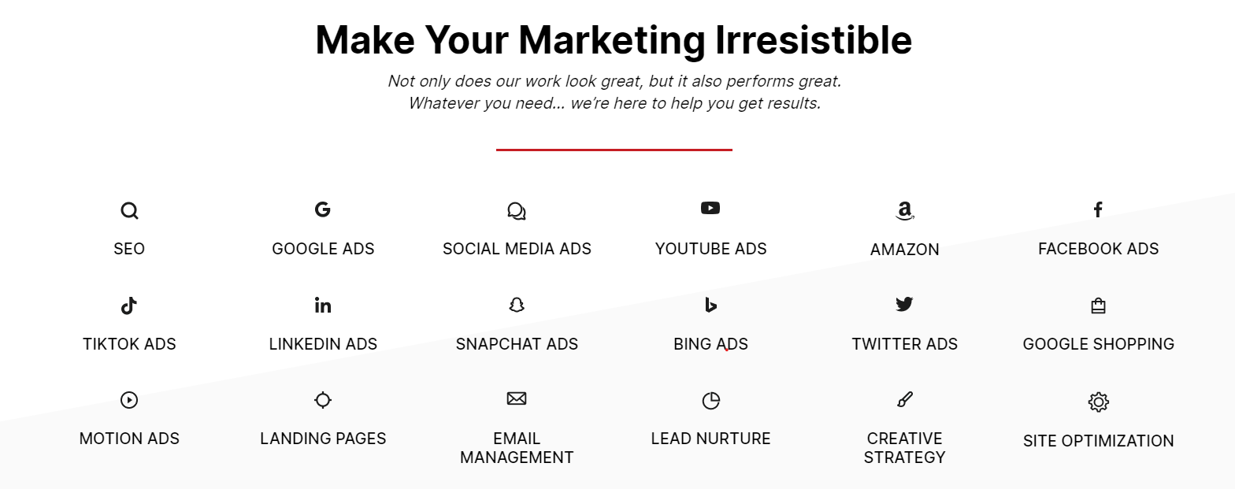
Our Services
Market gap
Costs
Few, if any, products on the market help customers like we do
Loss of productivity costing consumers thousands of dollars
Customers
Usability
66% of US consumers spend money on multiple products that only partially resolves their issue
Customers want something that is easy to use
Financials
Millennials account for about a quarter of the $48 billion spent on other products in 2018
20XX
Contoso business plan
<number>

Slide 10
Our Services in Social Media Management
Improve the brand awareness through social communities .
Keep engage the customers FB Groups & G+ Groups Posting.
Google plus posting ( same re-post from fb ads ) {We saw some conversion from Google Plus Channels} .
Twitter Interactions (Various people use hash tag, capture those users, also need separate tweet post instead of FB Cross Posting ).
Organize some giveaway or Contest : Twitter Contest, Facebook Contest, Instagram Contest Etc.
Seasonal Changes Promotions (Pre Planning Require and Social Strategy for any festival).
Monitoring #hashtag & tweets through Twitter Analytics.
Pinterest post creation & updating.
Re-pin in Pinterest followers & write valuable comment.
Monitoring Pinterest customer behavior through Pinterest analytic.
<number>

Slide 11
Our Services in Google AdWords and Other Paid Searches
We handle your AdWords account and create proper landing
page to generate better leads.
We will write effective add copy for Google search network
We will create Text Ads & Image Ads for Display Network
Competitive Analysis
Campaign Optimization
Keyword Research & Bid Management
A/B Ad Copy testing
Remarketing
Bid management, Monitoring, reporting
Conversion tracking
Ongoing Strategy Development
App promotion in Google AdWords display, search & YouTube
<number>

Slide 12




Call To Action +1 440876450
Notes:
<number>

Slide 13
Thank you
dainityinfo@gmail.com
www.dainity.com
<number>

